Slide 1
Machine Learning AIML CZG565
M3 : Linear Models for Regression

Slide 2
Agenda
Linear Model for Regression
Direct solution vs Iterative Method
Gradient Descent
Linear Basis Function
Notion of Bias vs Variance
Notes:
Machine Learning, Tom Mitchell
Read Chapter 1, 2 – Introduction to Machine Learning, 2nd edition, Ethem Alpaydin

Slide 3
ML workflow
Should I use ML on this problem?
Is there a pattern to detect?
Can I solve it analytically?
Do I have data?
Gather and organize data.
Preprocessing, cleaning, visualizing.
Choosing a model, loss, regularization, ...
Optimization
Hyperparameter search
Analyze performance and mistakes, and iterate back to step 5 (or 3)

Slide 4
Inductive Learning Hypothesis
Any hypothesis found to approximate the target function well over a sufficiently large set of training examples will also approximate the target function well over other unobserved examples
Inductive learning or “Prediction”:
Given examples of a function (X, F(X))
Predict function F(X) for new examples X
Classification
F(X) = Discrete
Regression
F(X) = Continuous
Probability estimation
F(X) = Probability(X):

Slide 5
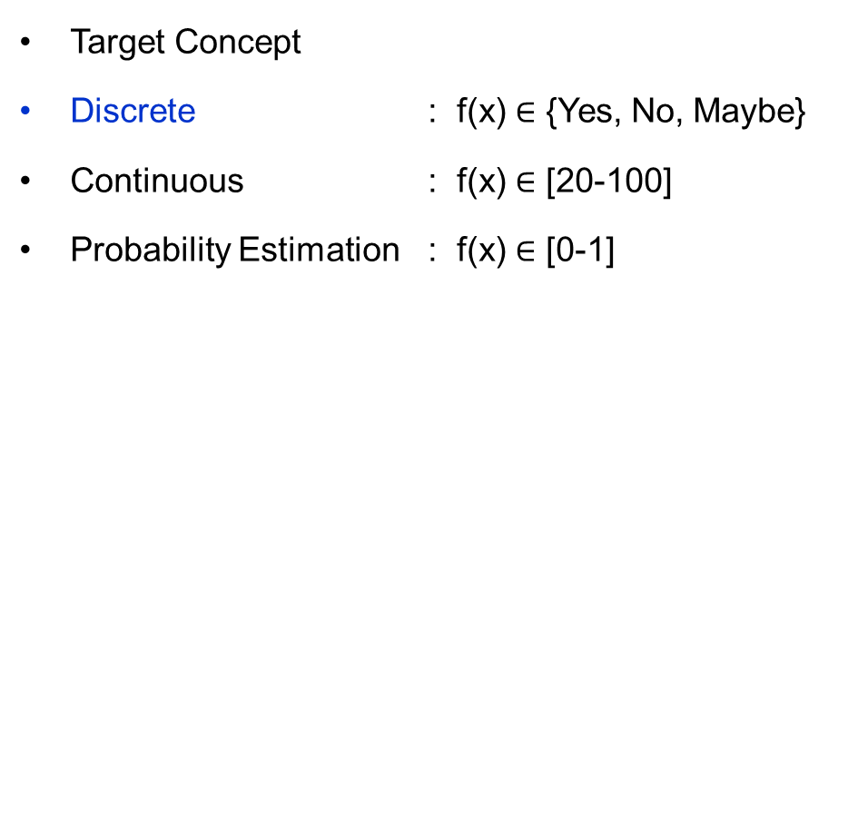
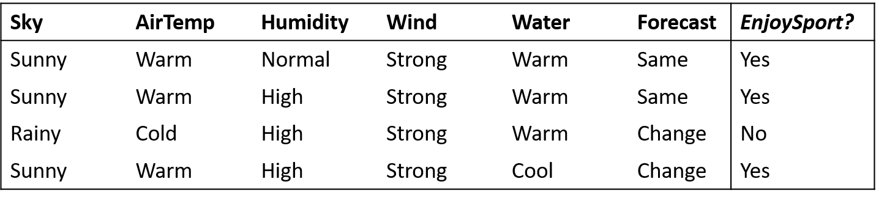
Inductive Learning Hypothesis
Classification
Regression

Slide 6
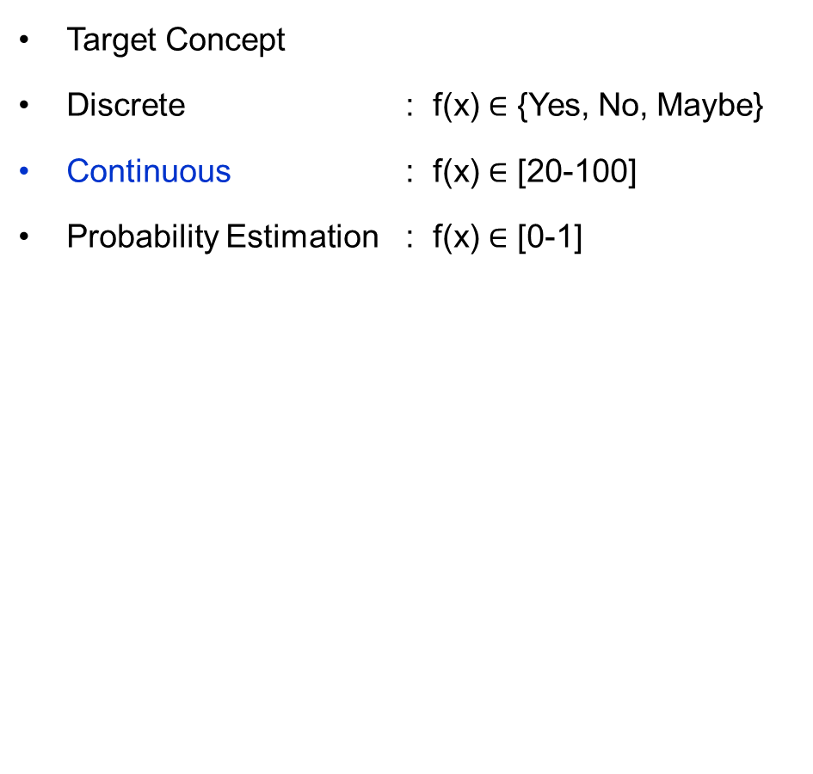
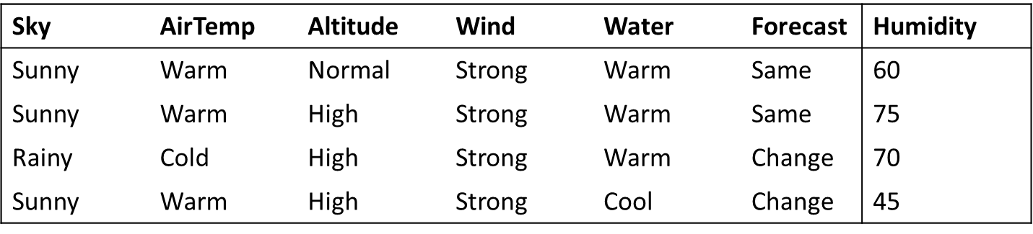
Inductive Learning Hypothesis
Classification
Regression

Slide 7
Linear Regression

Slide 8
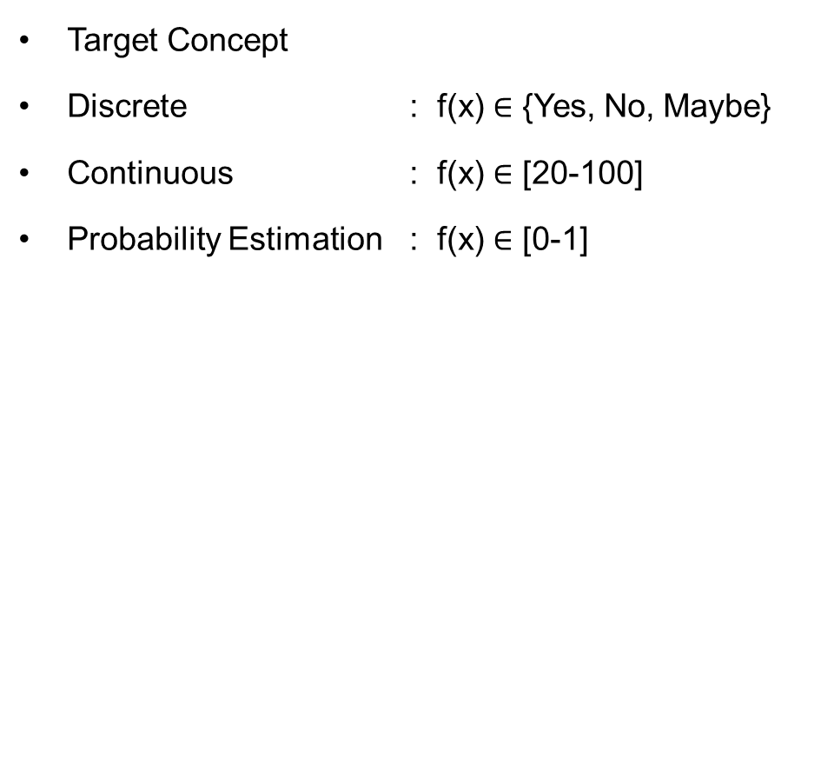
Inductive Learning Hypothesis : Interpretation
Classification
Regression

Slide 9


Formal Representation: Interpretation
Supervised Learning: Regression
GOAL : Previously unseen records should be assigned a value as accurately as possible.
Given (x₁, y₁), (x₂, y₂), ..., (x_{n}, y_{n})
Learn a function f (x) to predict y given x
– y is real-valued
9
8
7
6
5
4
3
2
1
0
1970 1980
September Arctic Sea Ice Extent (1,000,000 sq km)
1990
2000
2010
2020
Year Number

Slide 10

Formal Representation: Interpretation
Supervised Learning: Regression
GOAL : Previously unseen records should be assigned a value as accurately as possible.
Given (x₁, y₁), (x₂, y₂), ..., (x_{n}, y_{n})
Learn a function f (x) to predict y given x
– y is real-valued
9
8
7
6
5
4
3
2
1
0
1970 1980
September Arctic Sea Ice Extent (1,000,000 sq km)
1990
2000
2010
2020
Year Number

Slide 11
Formal Representation: Interpretation
Supervised Learning: Regression
GOAL : Previously unseen records should be assigned a value as accurately as possible.
Given (x₁, y₁), (x₂, y₂), ..., (x_{n}, y_{n})
Learn a function f (x) to predict y given x
– y is real-valued
9
8
7
6
5
4
3
2
1
0
1970 1980
September Arctic Sea Ice Extent (1,000,000 sq km)
1990
2000
2010
2020
Year Number

Slide 12
Formal Representation: Interpretation
Supervised Learning: Regression
GOAL : Previously unseen records should be assigned a value as accurately as possible.
Given (x₁, y₁), (x₂, y₂), ..., (x_{n}, y_{n})
Learn a function f (x) to predict y given x
– y is real-valued
9
8
7
6
5
4
3
2
1
0
1970 1980
September Arctic Sea Ice Extent (1,000,000 sq km)
1990
2000
2010
2020
Year Number

Slide 13
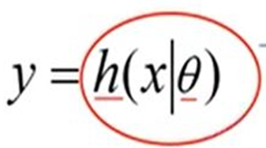

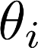
Machine Learning Process : Interpretation
Training Set
Price
(in 1000s of dollars)
Learning Algorithm
Size (feet²)
Size in feet² (x) | Price ($) in 1000's (y)
2104 | 460
1416 | 232
1534 | 315
852 | 178
… | …
Size of house
h
Estimated price
Hypothesis:
‘s : Parameters
h(.) : Model
How to choose ‘s ?

Slide 14
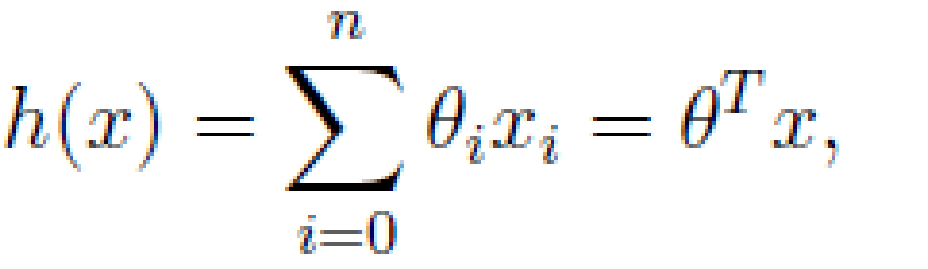
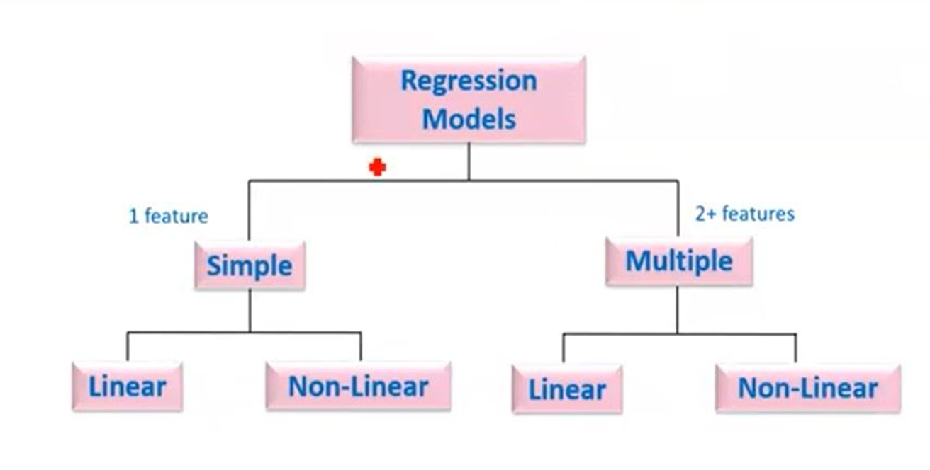
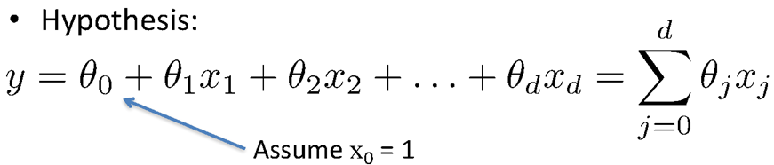
Types of Regression Models
Simple Linear regression model
(Education) x y (Income)
(Education) x₁
(Soft Skills) x₂
(Experience) x₃
(Age) x₄
Multiple Linear regression model
y (Income)

Slide 15

Learning the Model Parameters
Closed Form Solution Approach
Gradient Descent Approach

Slide 16
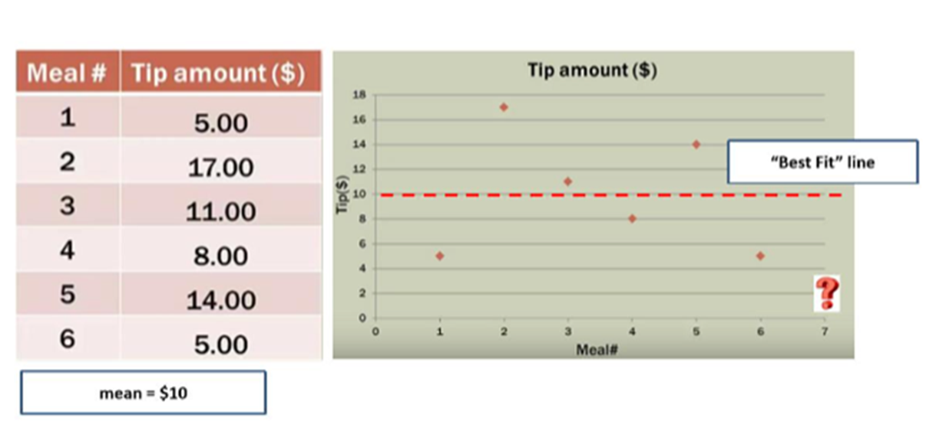
Notion of Cost Function
y = ɵ₀
y = ɵ₀

Slide 17
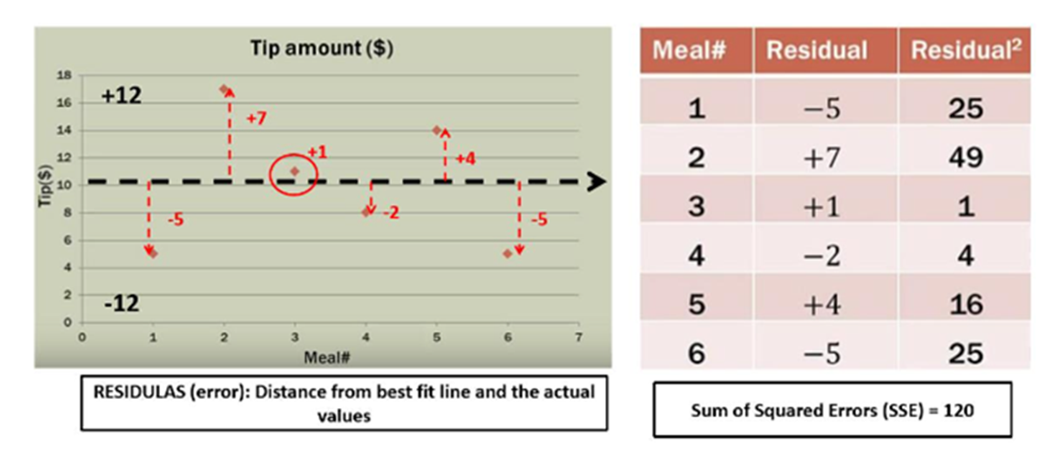
Notion of Cost Function

Slide 18
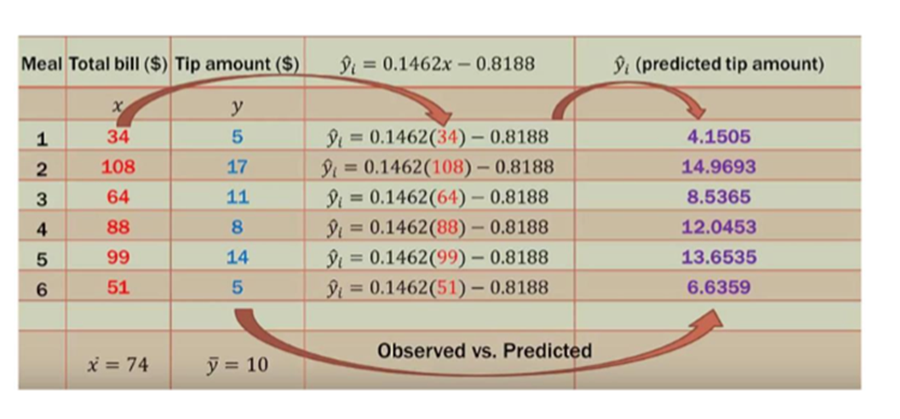
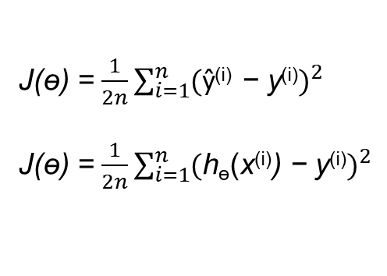
Notion of Cost Function
y = ɵ₀ + ɵ₁ x

Slide 19
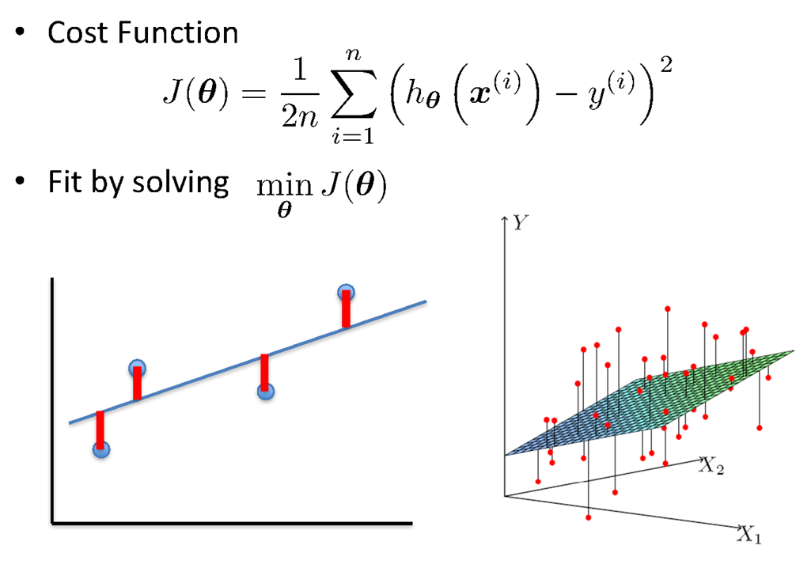
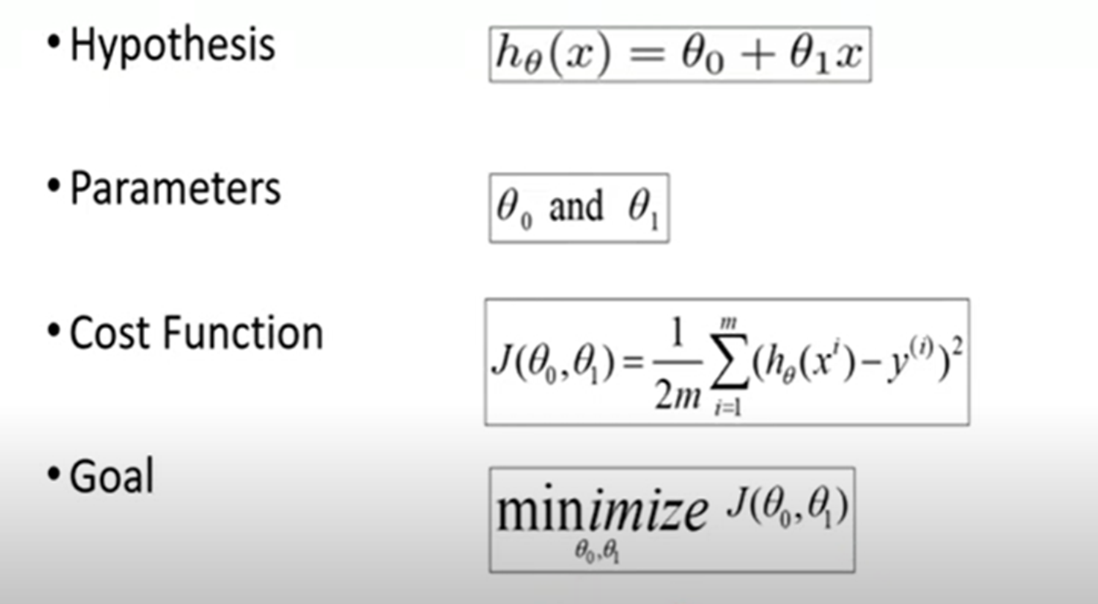
Linear Regression : Least Squares

Slide 20
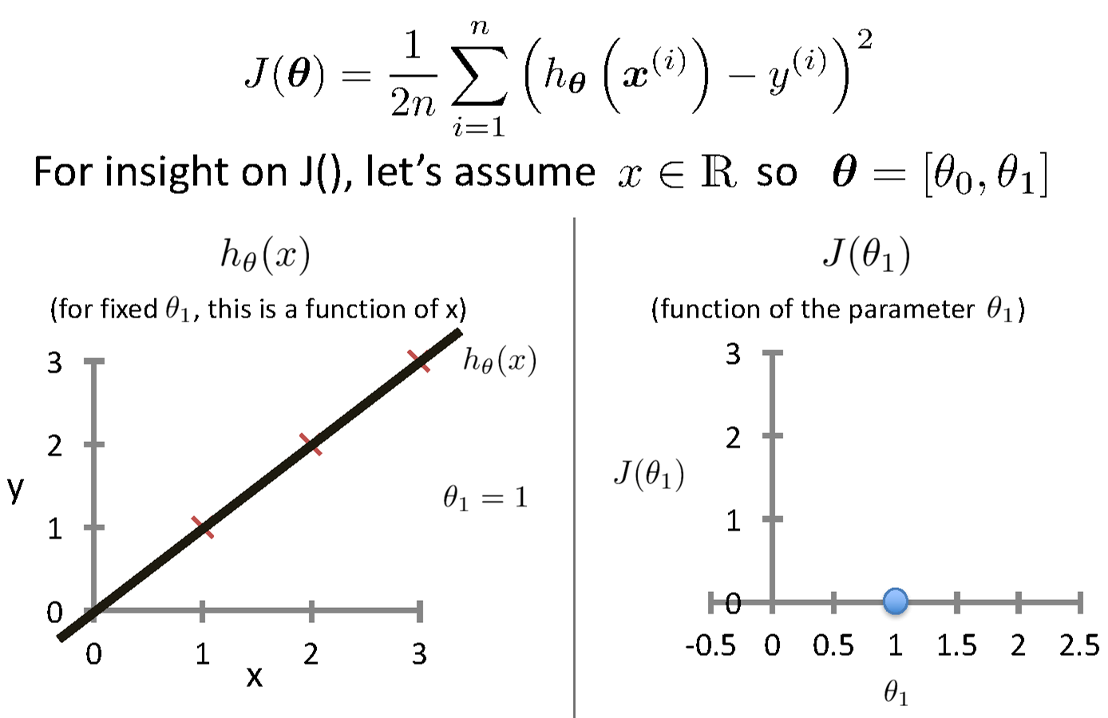
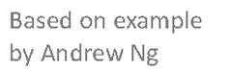
Intuition Behind Cost Function
Source Credit :

Slide 21
Intuition Behind Cost Function
Source Credit :

Slide 23
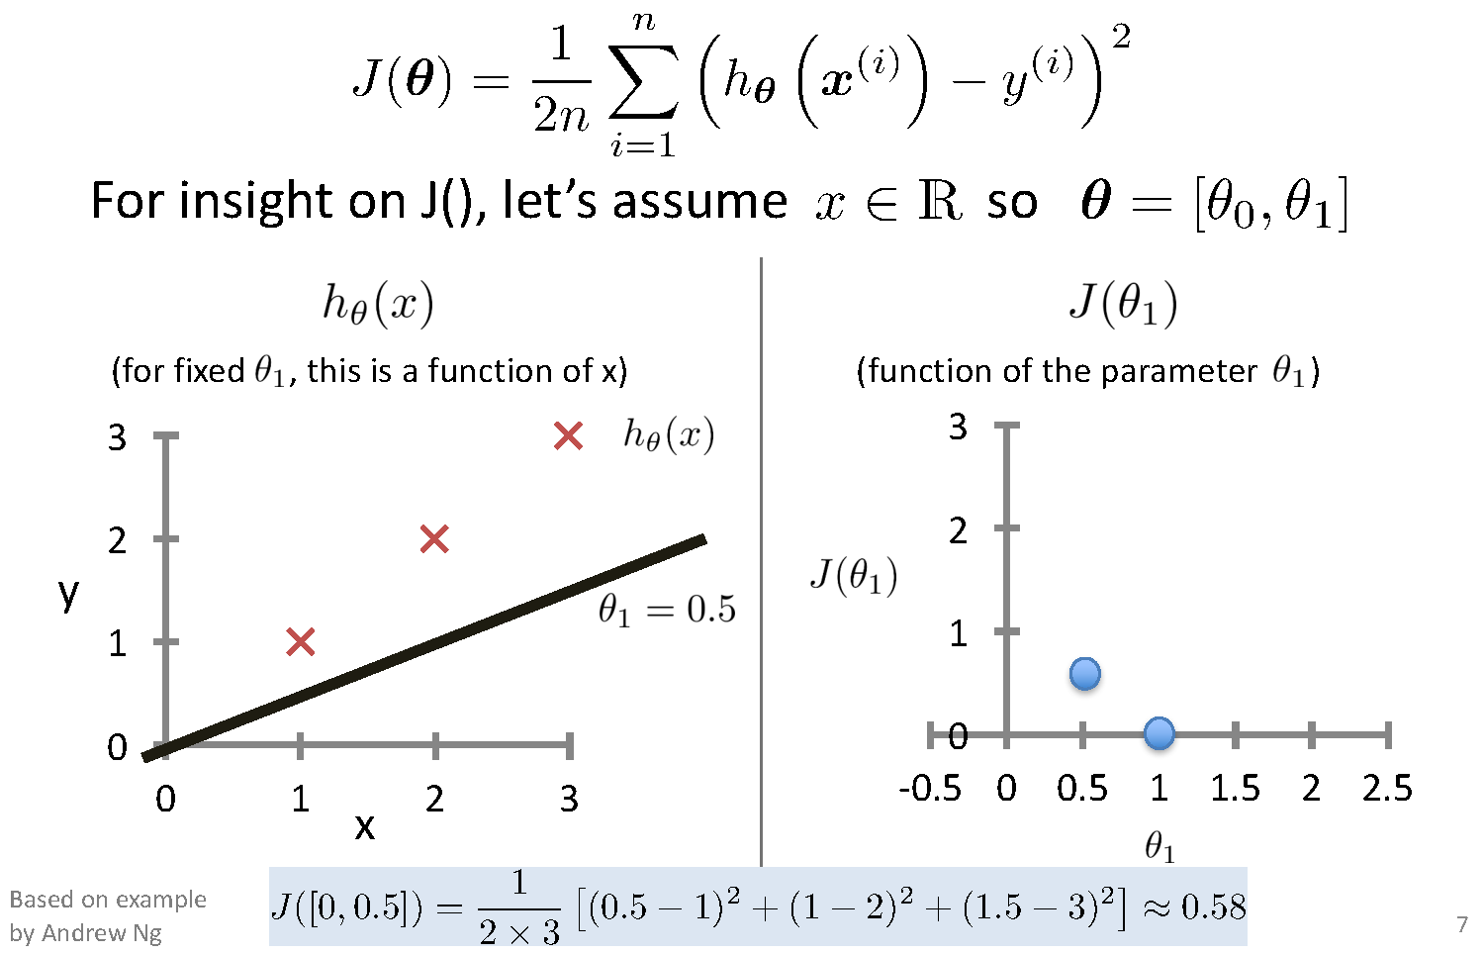
Intuition Behind Cost Function

Slide 24
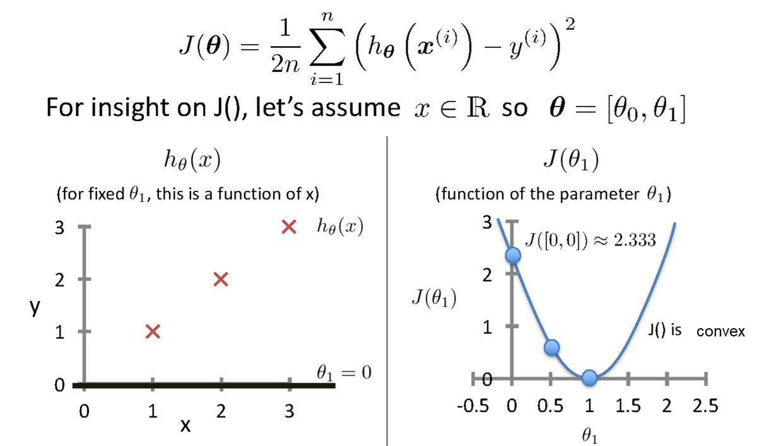
Intuition Behind Cost Function
Source Credit :

Slide 25
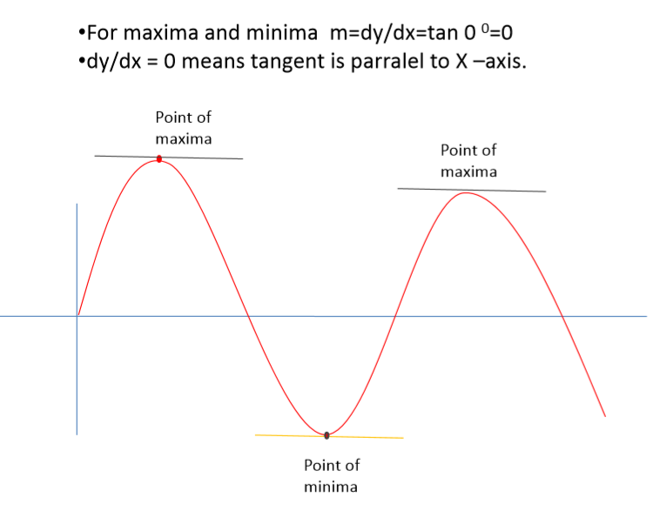
Notion of Maxima and Minima of a function
In General

Slide 26
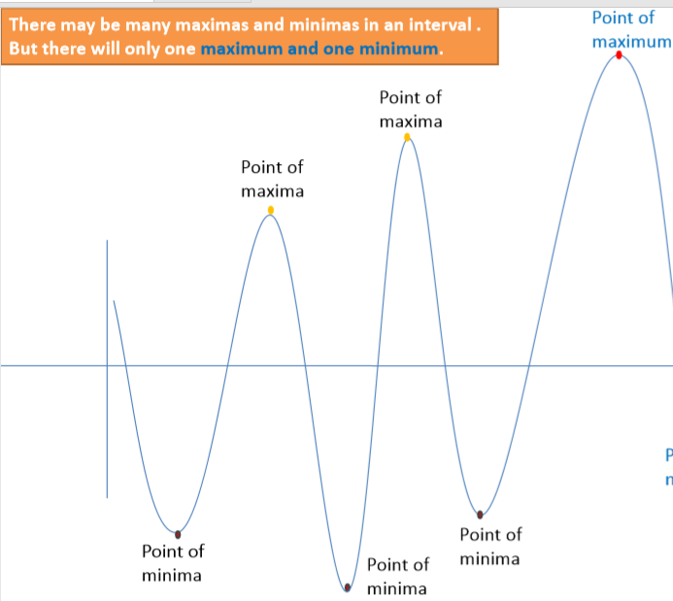
Notion of Maxima and Minima of a function
In Machine Learning
CarPrice = 1 + 0.05Mileage
CarPrice = 1 + 0.25Mileage
CarPrice = 1 + 0.75Mileage
15.7
15.3
Weight of Mileage
Mileage (in kmpl) | Car Price (in cr)
9.8 | 10.48
9.12 | 1.75
9.5 | 6.95
10 | 2.51
12.4
Sum of absolute Error
/ Training Error

Slide 27
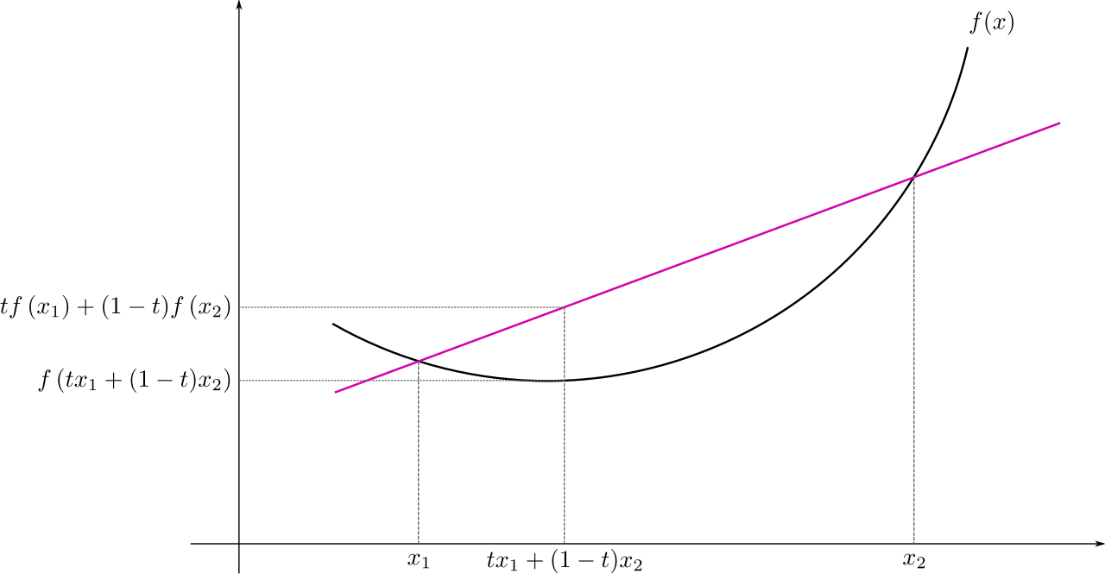
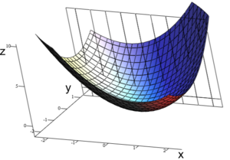
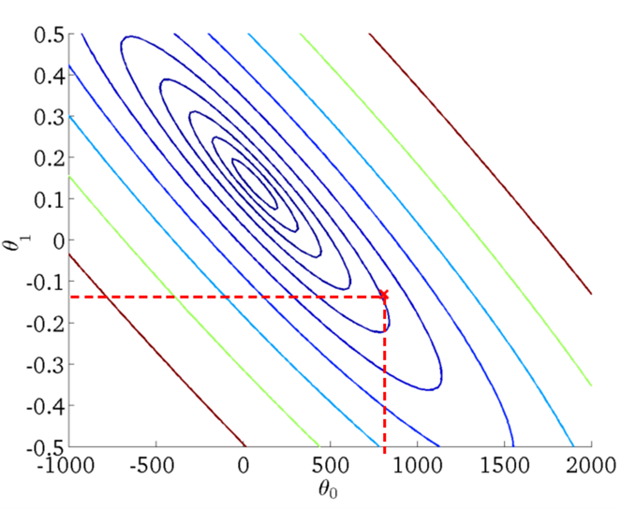
: Multivariate View
Convex Function
Real-valued function defined on an n-dimensional interval is called convex if the line segment between any two points on the graph of the function lies above or on the graph

Slide 28
Learning Model Parameters Closed Form Solution

Slide 29
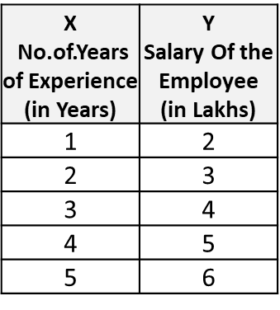
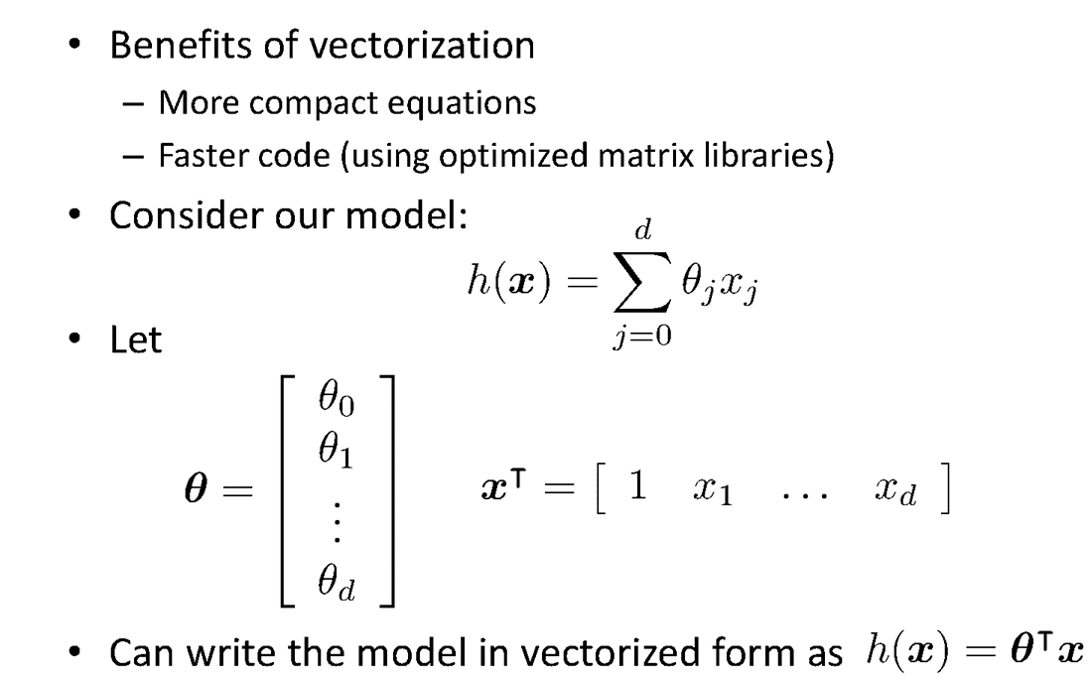
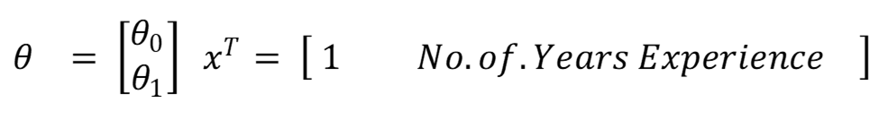
Vectorization

Slide 30
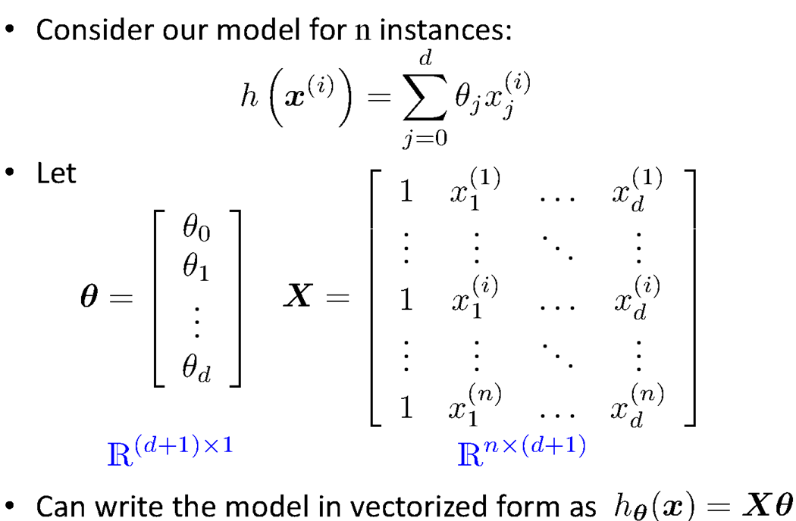
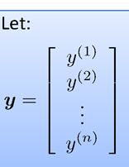
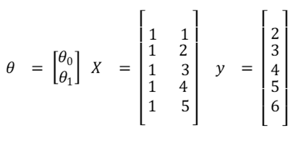
Vectorization

Slide 31
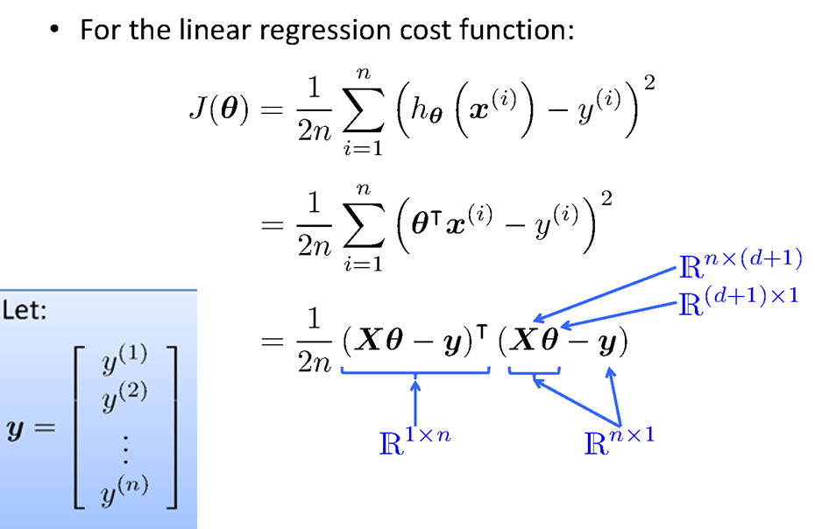
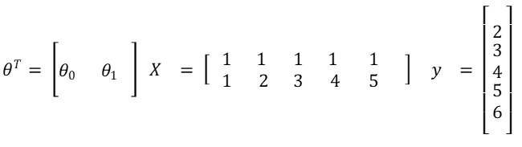
Vectorization

Slide 32
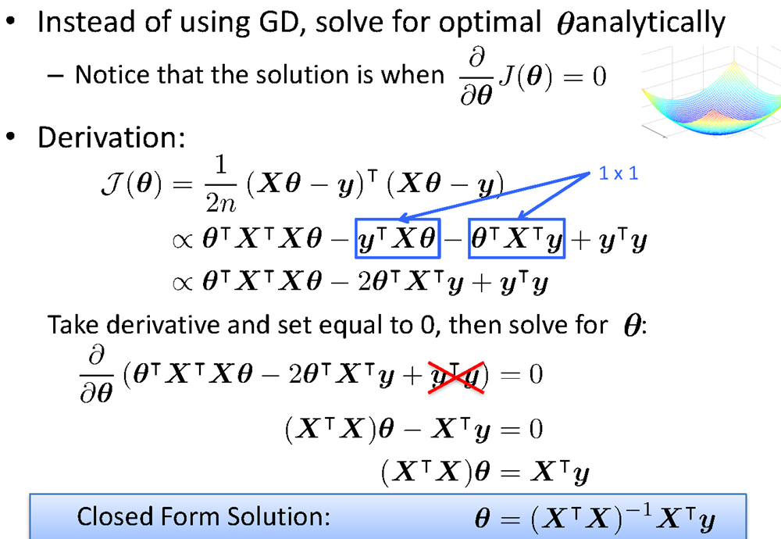
Vectorization

Slide 33
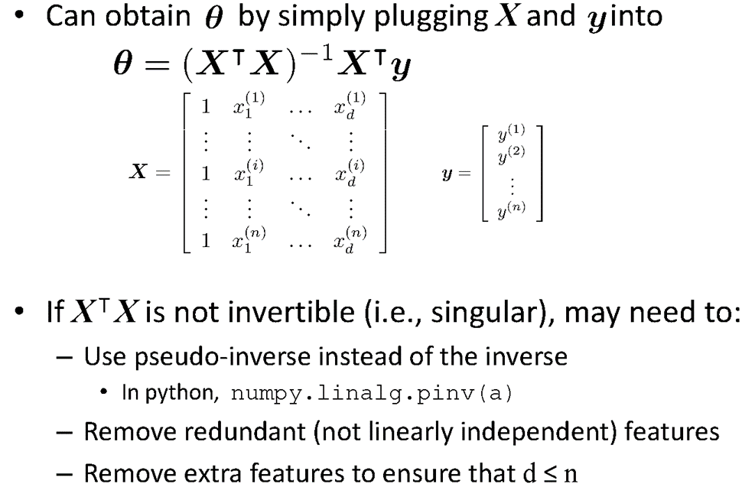
Vectorization

Slide 34
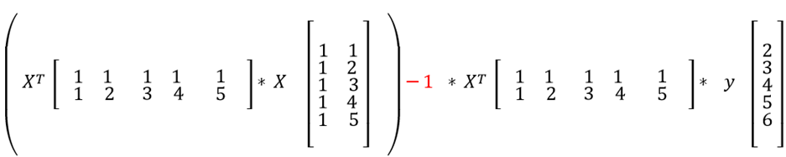
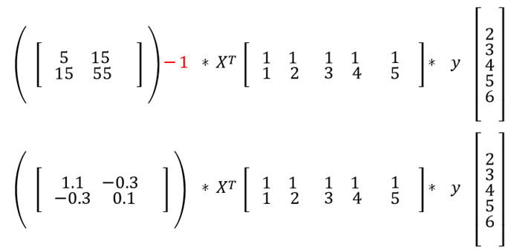
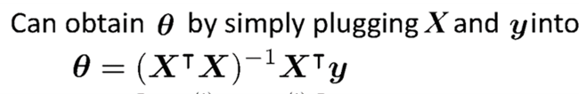
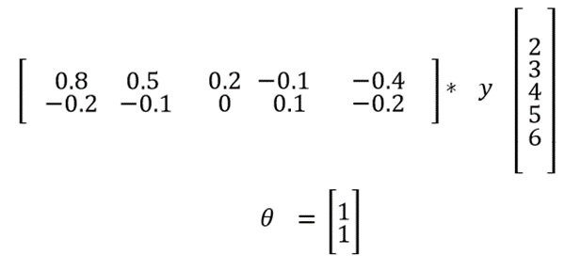
Fit the Linear Regression Model :
Using Closed Form – Problem Type 1

Slide 35
Learning Model Parameters Gradient Descent Approach

Slide 36
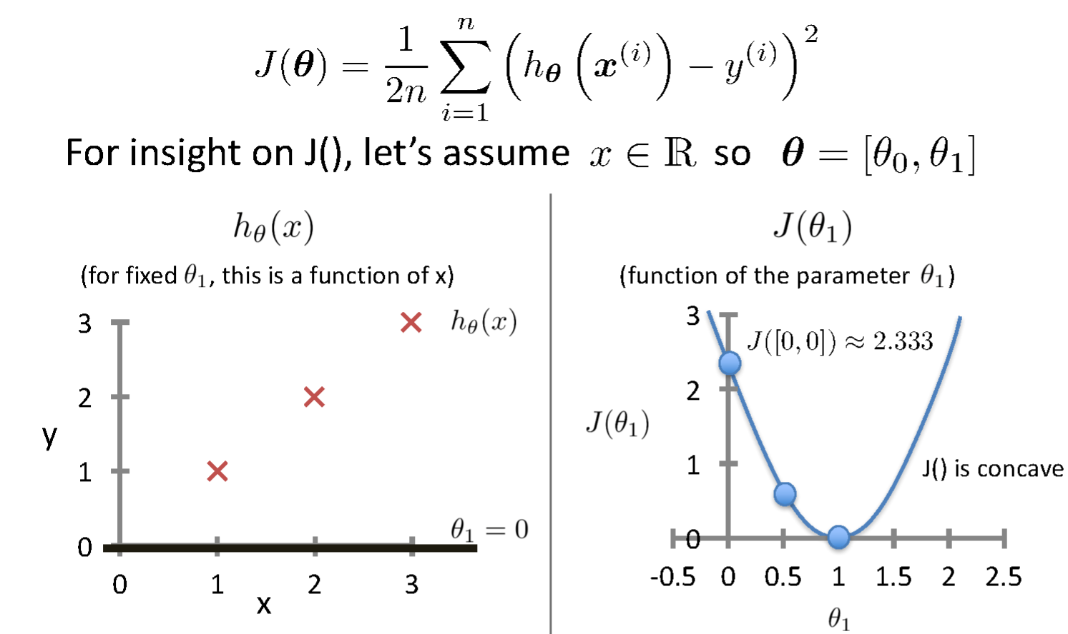
Intuition Behind Cost Function
Source Credit :

Slide 37
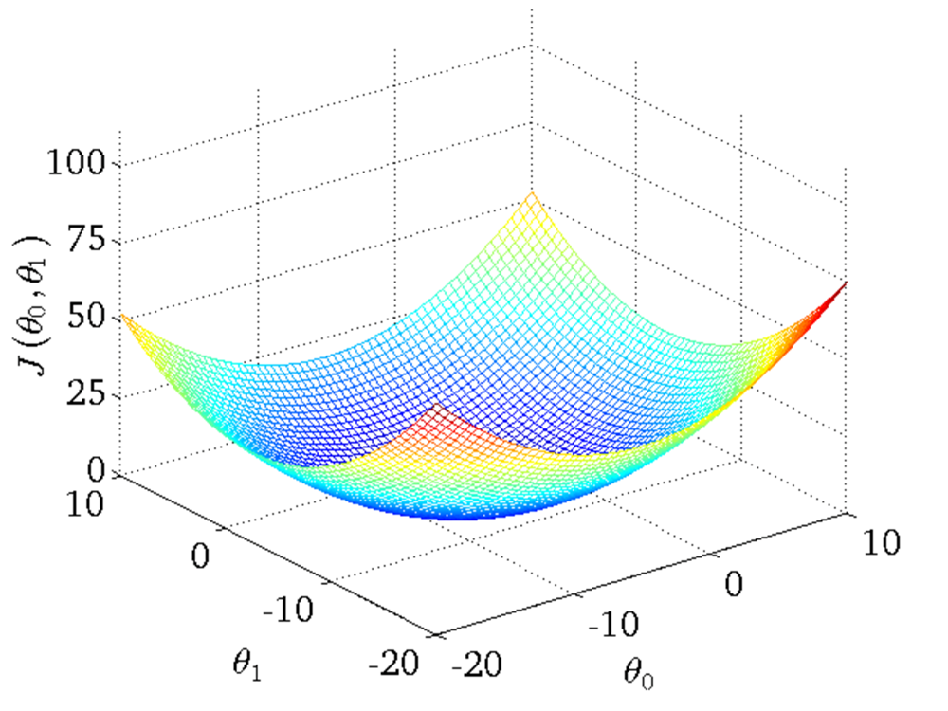
Intuition Behind Cost Function
Source Credit :

Slide 38
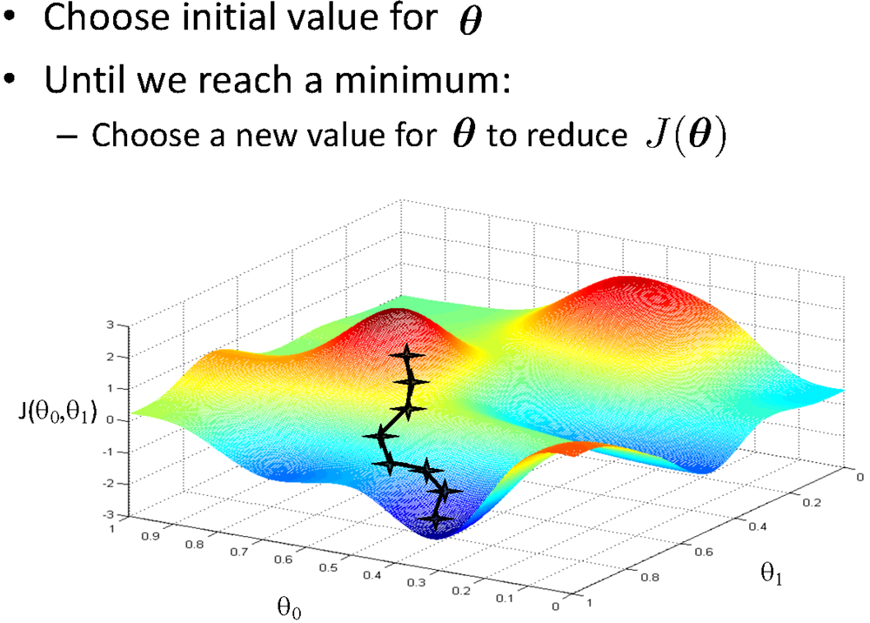
Basic Search Procedure
Source Credit : Figure by Andrew Ng

Slide 39
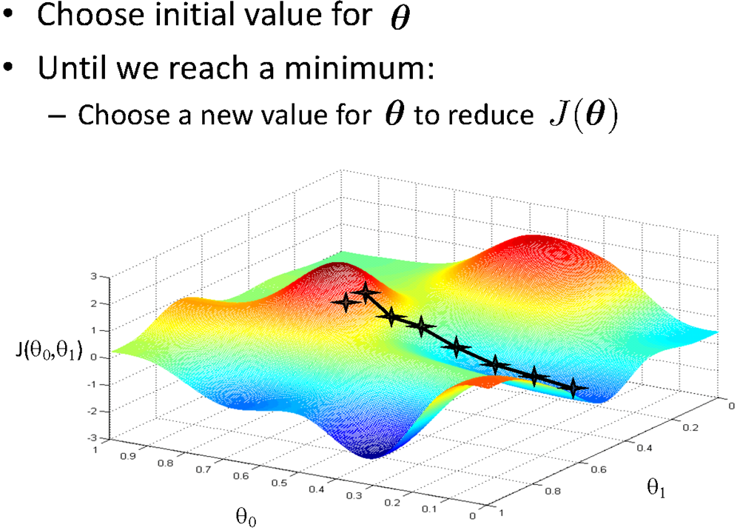
Basic Search Procedure
Source Credit : Figure by Andrew Ng

Slide 40
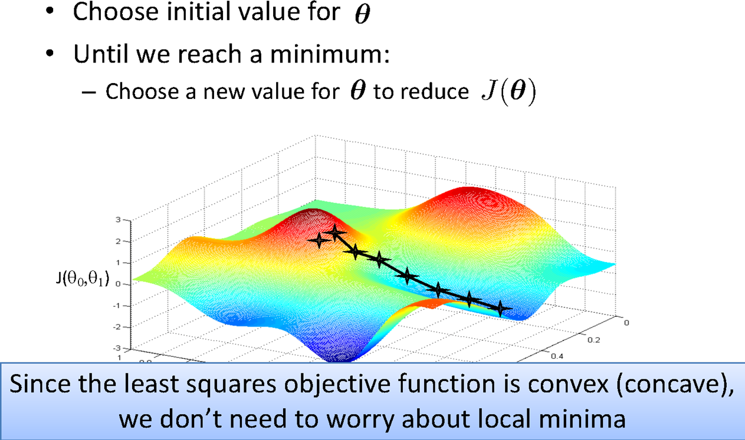
Basic Search Procedure
Source Credit : Figure by Andrew Ng

Slide 41
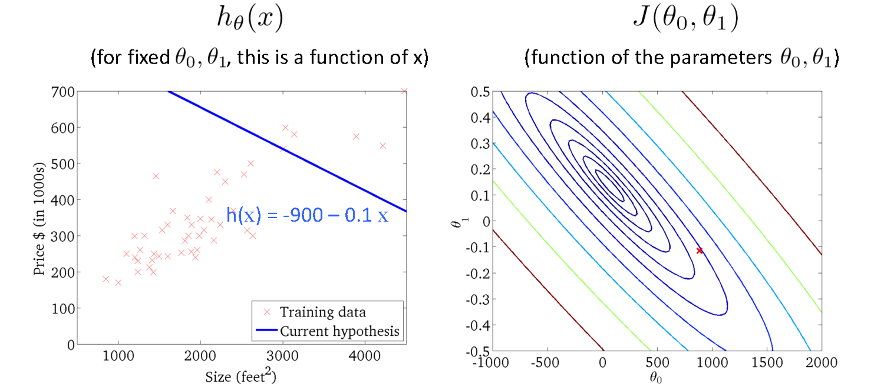
Size in feet² (x) | Price ($) in 1000's (y)
2104 | 460
1416 | 232
1534 | 315
852 | 178
… | …
Gradient Descent
Source Credit : Slide by Andrew Ng

Slide 42
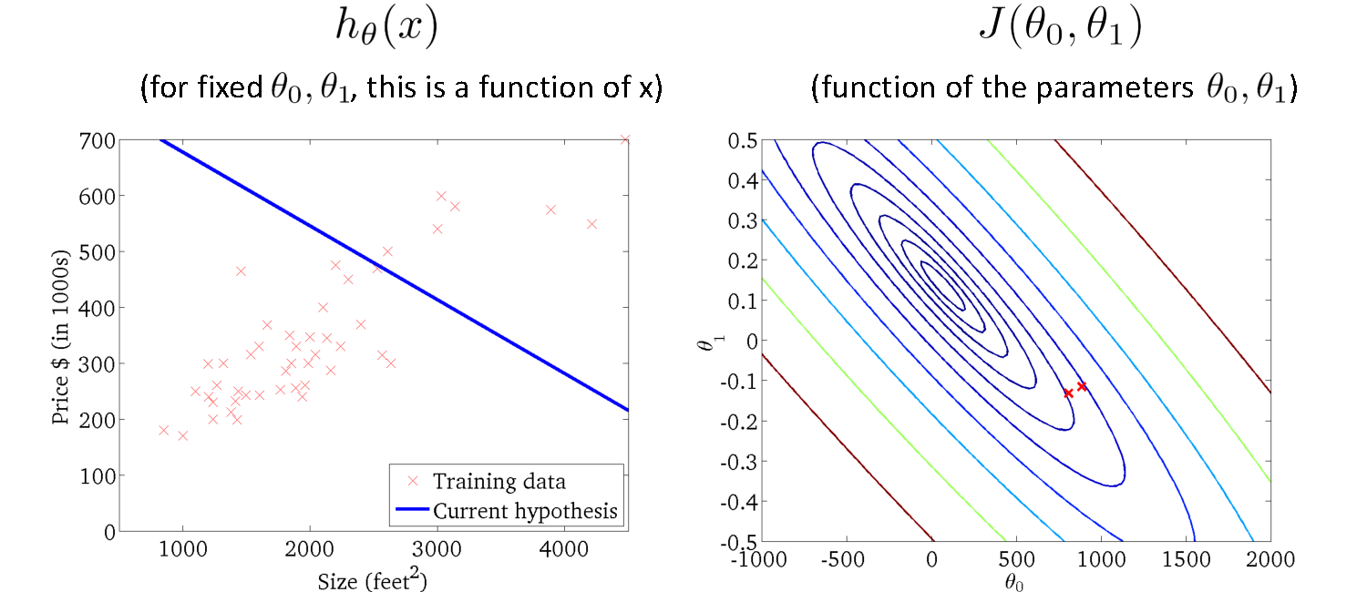
Gradient Descent
Source Credit : Slide by Andrew Ng

Slide 43
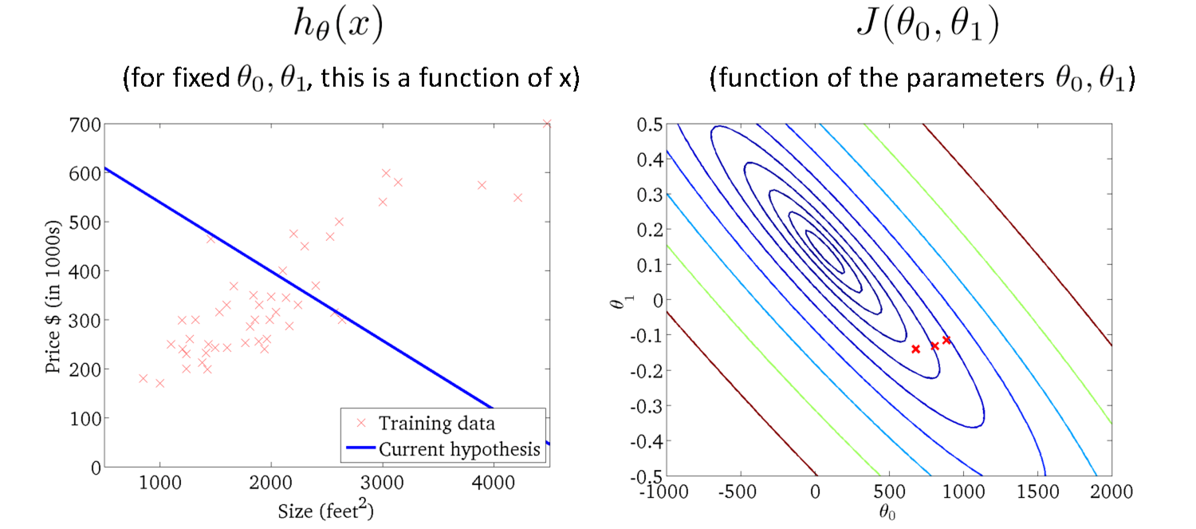
Gradient Descent
Source Credit : Slide by Andrew Ng

Slide 44
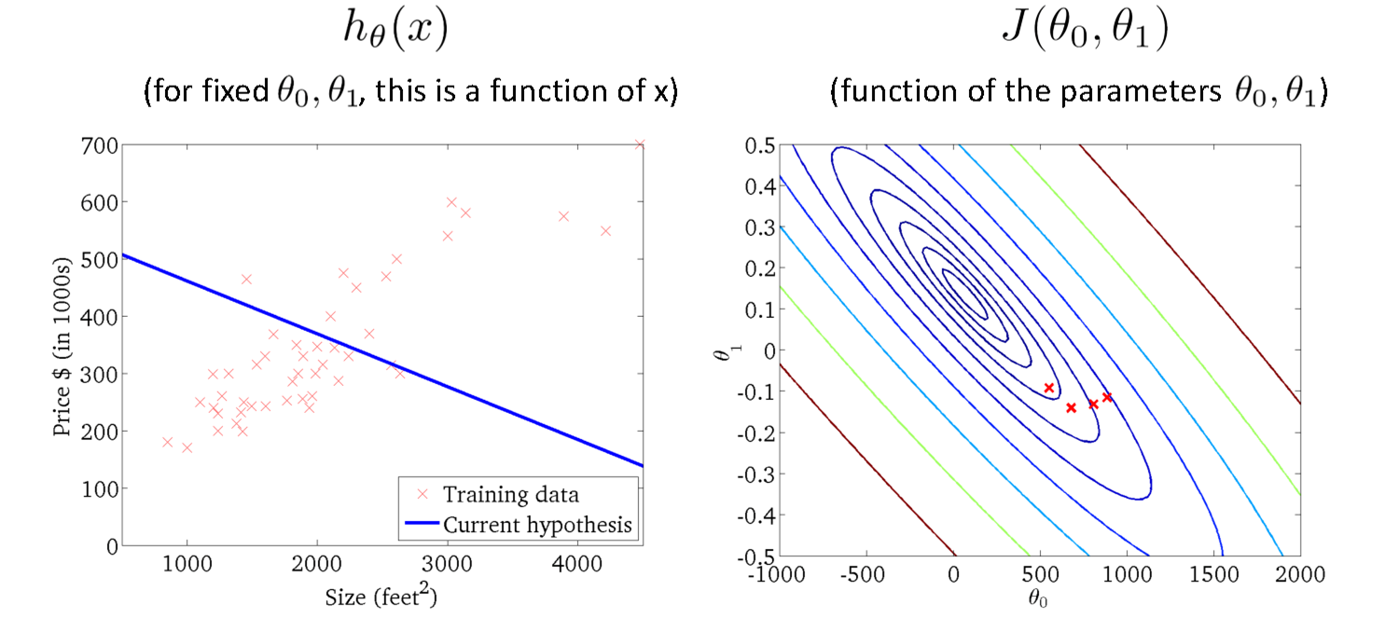
Gradient Descent
Source Credit : Slide by Andrew Ng

Slide 45
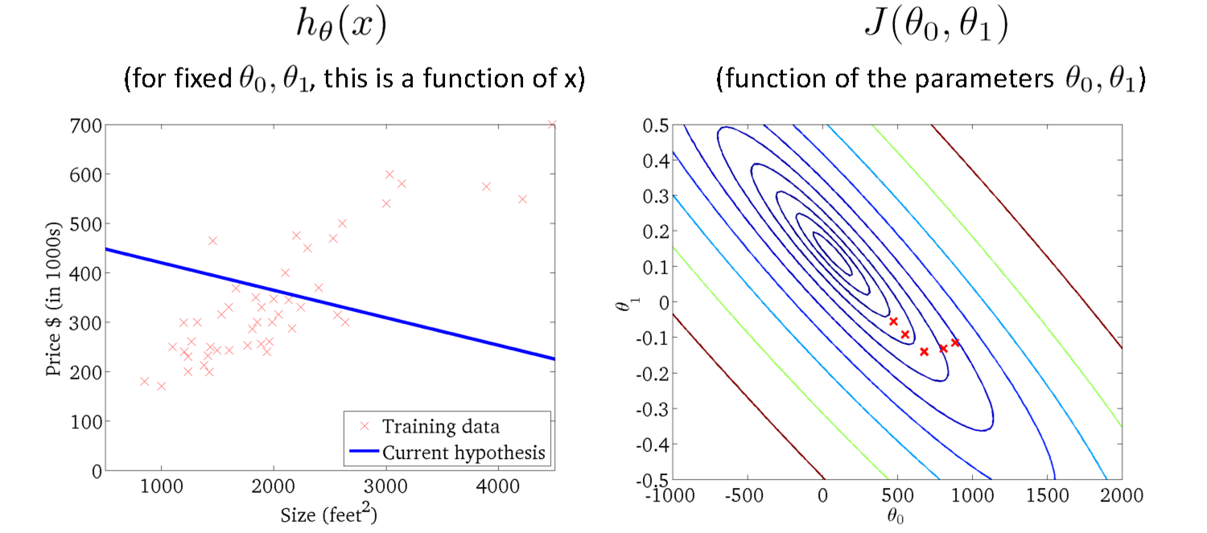
Gradient Descent
Source Credit : Slide by Andrew Ng

Slide 46
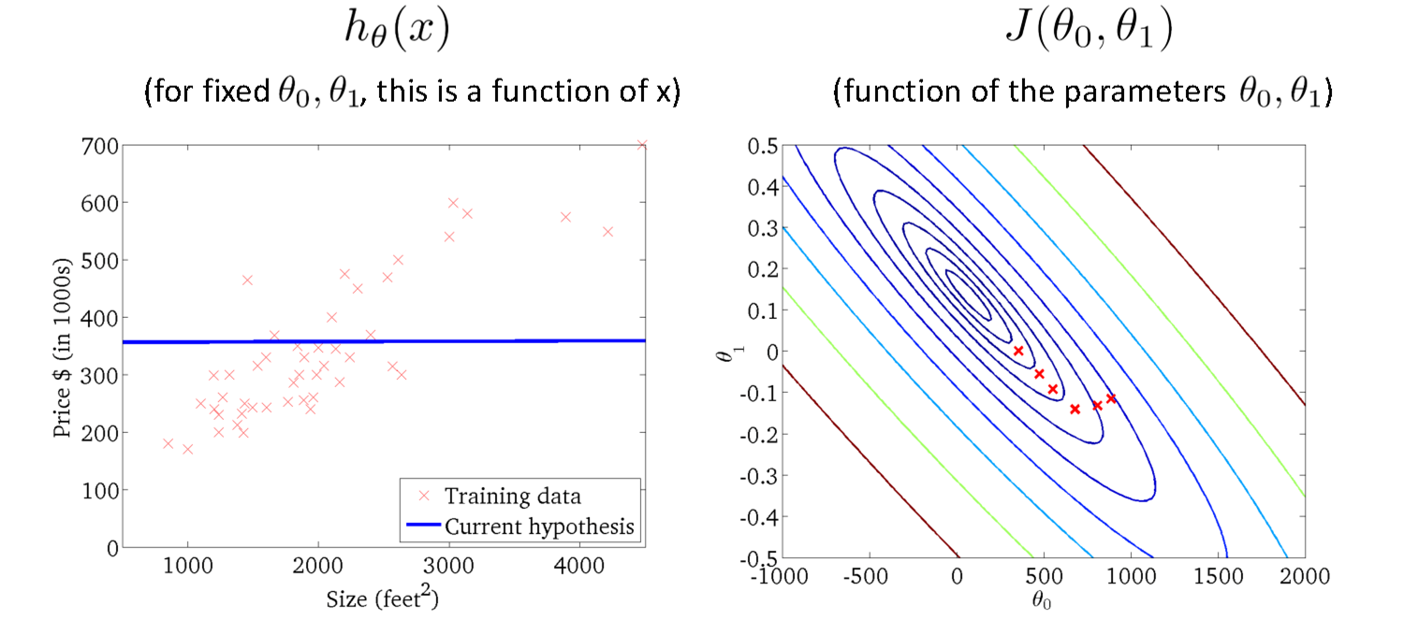
Gradient Descent
Source Credit : Slide by Andrew Ng

Slide 47

Gradient Descent
Source Credit : Slide by Andrew Ng

Slide 48

Gradient Descent
Source Credit : Slide by Andrew Ng

Slide 49

Gradient Descent
Source Credit : Slide by Andrew Ng

Slide 50

Gradient Descent

Slide 51

Gradient Descent

Slide 52

Gradient Descent for Linear Regression

Slide 53






Guarantee of Convergence
Positive Derivative
𝞱₁
𝞱₁
𝞱₁
New 𝞱₁
Old 𝞱₁
Source Credit: Prof. Mohammad Hammoud

Slide 54



Guarantee of Convergence
Negative Derivative
𝞱₁
𝞱₁
𝞱₁
Old 𝞱₁
New 𝞱₁
Source Credit: Prof. Mohammad Hammoud

Slide 55

Choosing Learning Rate

Slide 56

Gradient Descent algorithm : Effect of Feature Scaling

Slide 57

Gradient Descent algorithm : Effect of Learning Rate :
Problem Type 2 – Interpretation of Convergence or Effect of Hyper parameters

Slide 58
Fit a linear Regression Line : Gradient Descent : Problem Type 3
Steps :
(Assuming : ‘n’ no.of.instances and two predictors {x1, x2} and linear regression)
Identification of the equations y = w0+w1X1+W2X2
Cost function & derivative
W0` = w0 – 1/n * learning rate * (sum (w0+w1X1+W2X2 - y))
W1` = w1 – 1/n * learning rate * (sum (w0+w1X1+W2X2 - y) * x1)
W2` = w2 – 1/n * learning rate * (sum (w0+w1X1+W2X2 - y)*x2)
Apply the equations

Slide 59

Fit a linear Regression Line : Gradient Descent
Fit a linear regression. Show only the first iteration of Gradient descent algorithm using learning rate of 0.02 for the following data , if the Relative Risk of Coronary Heart Disease is believed to be only linearly dependent on BMI as well as Diastolic Pressure. Assume the intercept of the regression model as 5 and the slope of independent variables as -0.03 (negative).
Steps :
Identification of the equations y = w0+w1X1+W2X2
Cost function & derivative
W0` = w0 – 1/3 * learning rate * (sum (w0+w1X1+W2X2 - y))
W1` = w1 – 1/3 * learning rate * (sum (w0+w1X1+W2X2 - y) * x1)
W2` = w2 – 1/3 * learning rate * (sum (w0+w1X1+W2X2 - y)*x2)
Apply the equations

Slide 60
Fit a linear Regression Line : Gradient Descent
Fit a linear regression. Show only the first iteration of Gradient descent algorithm using learning rate of 0.02 for the following data , if the Relative Risk of Coronary Heart Disease is believed to be only linearly dependent on BMI as well as Diastolic Pressure. Assume the intercept of the regression model as 5 and the slope of independent variables as -0.03 (negative).
Steps :
Identification of the equations: RR-CHD = 5 – 0.03 * BMI – 0.03 * DiastolicPressure
Cost function & derivative
W0` = w0 – 1/3 * 0.02 * (sum (5-0.03BMI-0.03DiastolicPresure - RRCHD))
= 5 – 1/3 * 0.02 * (sum (5-0.03BMI-0.03DiastolicPresure - RRCHD))
W1` = w1 – 1/3 * 0.02 * (sum (5-0.03BMI-0.03DiastolicPresure - RRCHD) * BMI)
= -0.03 – 1/3 * 0.02 * (sum (5-0.03BMI-0.03DiastolicPresure - RRCHD) * BMI)
W2` = w2 – 1/3 * 0.02 * (sum (5-0.03BMI-0.03DiastolicPresure - RRCHD) * DiastolicPresure)
= -0.03 – 1/3 * 0.02 * (sum (5-0.03BMI-0.03DiastolicPresure - RRCHD) * DiastolicPresure)
Apply the equations : Answer at the end of first iteration:
W0 = 5.0016 , W1 = 0.0476, w2= 0.179

Slide 61

Closed Form Solution Vs. Gradient Descent

Slide 62
Types of Gradient Descent Algorithms

Slide 63

Gradient Descent: Variants
Batch gradient descent refers to calculating the derivative from all training data before calculating an update.
Minibatch refers to calculating derivative of mini groups of training data before calculating an update.
Stochastic gradient descent refers to calculating the derivative from each training data instance and calculating the update immediately

Slide 64

Gradient Descent: Variants

Slide 65

Gradient Descent: Variants

Slide 66

Gradient Descent: Variants

Slide 67


Gradient Descent: Variants - Effect on Convergence

Slide 68
Evaluation Metrics

Slide 69




Evaluation of Linear Regression Model
Mileage (in kmpl) | Car Price (in cr)
9.8 | 10.48
9.12 | 1.75
9.5 | 6.95
10 | 2.51
…. | …..
Unseen Data
Mileage (in kmpl) | Car Price (in cr)
7.5 | 9.25
10 | 6.5
…. | …..
Model 1
CarPrice = 8.5 + 0.5 Mileage – 1.5 Mileage²
Model 2
CarPrice = -5.5 + 1.5 Mileage

Slide 70

Evaluation of Linear Regression Model R-squared
variation in ‘y’ that is explained by a regression model
Mileage (in kmpl) | Car Price (in cr)
9.8 | 10.48
9.12 | 1.75
9.5 | 6.95
10 | 2.51
…. | …..
Car Price (in cr)
10.48
1.75
6.95
2.51
Mean Y
variation in ‘y’ that is not captured/explained by a regression model
Model 1
CarPrice = 8.5 + 0.5 Mileage – 1.5 Mileage²
variation that is explained by a regression model
measures the goodness of fit of a regression model

Slide 71
Linear Basis Models
What if output is a non-linear function of input vector?

Slide 72




Polynomial Regression
17 / 22

Slide 73





Linear Basis Function Models

Slide 74



Linear Basis Function Models
Example: an M-th order polynomial function of one dimensional feature x :
where x^{j} = j-th power of x
Φ_{j}(x) are known as basis functions. Typically, Φ₀(x) = 1, so that w₀ acts as a bias.
In the simplest case, we use linear basis functions : Φ_{d}(x) = x_{d}.
They are called linear models because this function is linear in w.

Slide 75







Linear Basis Function Models - Examples

Slide 76
Notion of Bias - Variance

Slide 77

Quality of Fit

Slide 78

Handling Overfitting – Way 1
Increase in Size of the data set reduces the over-fitting problem

Slide 79


Effect of Training Size on Over fitting Problem Type 4 : Interpretation of the Model Fit
Size of training dataset needs to be large to prevent overfitting when higher order model is used.
Higher order model
Lower order model

Slide 80

Polynomial Fitting can lead to Overfitting
Handling Overfitting – Way 2 – Reduce the complexity of the model
Underlying target function is quadratic
Linear model results in under fitting with large bias
Polynomial of order 300 results in a large variance

Slide 81

How to experiment on Model Complexity ?

Slide 82

Handling Overfitting – Way 3
Early Stop the Training

Slide 83
Regularization (*This notion is common for both Linear Regression – Module 3 and Logistic Regression – Module 4)

Slide 84

Overfitting vs Underfitting
Overfitting
Underfitting
Fitting the data too well
Features are noisy / uncorrelated to concept
Learning too little of the true concept
Features don’t capture concept
Too much bias in model

Slide 85

Regularization

Slide 86

Regularization

Slide 87

Understanding Regularization

Slide 88

Understanding Regularization

Slide 89

Understanding Regularization

Slide 90


Regularization
Ridge Regression / Tikhonov regularization

Slide 91




Regularization
Lasso Regression (Least Absolute Shrinkage and Selection Operator Regression)

Slide 92



Regularization
Elastic Net
+ r
Control the regularization using the Mix Ration “r”:
When,
r = 0, Elastic Net is equivalent to Lasso Regression,
r = 1, it is equivalent to Ridge Regression
from sklearn.linear_model import ElasticNet
ElasticNet(alpha=0.1, l1_ratio=0.5)

Slide 93
How to choose the right Regularization?
Common Usage & Observation
L1 regularization has the ability to set some coefficients to 0 exactly leading to a sparse model
L1 regularization helps in feature selection by eliminating the features that are not important
L1 cannot be used efficiently in gradient-based approaches since it is not-differentiable unlike L2
L2 will in general lead to small magnitudes of weights but not exactly 0.
Elastic net – Prefer in Highly correlated features

Slide 94
Numerical Exercise – For Student Practice
Fit a linear regression. Show only the first iteration of Gradient descent algorithm using learning rate of 0.02 for the following data , if the Relative Risk of Coronary Heart Disease is believed to be only linearly dependent on BMI as well as Diastolic Pressure. Assume the intercept of the regression model as 5 and the slope of independent variables as -0.03 (negative).
Apply a regularization on the same problem with regularization constant 5 and apply GD for 2 iterations & interpret the results. Try both ridge regression as well as lasso regression. Below equation is changed only for ridge regression. Students must apply appropriate GD update equation changes for this problem.
Steps :
Identification of the equations y = w0+w1X1+W2X2
Cost function & derivative
W0` = w0 – 1/3 * learning rate * (sum (w0+w1X1+W2X2 - y))
W1` = w1* (1- learning rate * regularization constant) – 1/3 * learning rate * (sum (w0+w1X1+W2X2 - y) * x1)
W2` = w2 * (1- learning rate * regularization constant) – 1/3 * learning rate * (sum (w0+w1X1+W2X2 - y)*x2)
Apply the equations

Slide 95
Python Lab Exercise – For Student Practice
Go to your virtual lab file under : Machine Learning 🡪 LabCapsule 2 Linear _ Polynomial Regression 🡪 3 Polynomial Regression
Download ML_Lab 5 PolynomialRegression.ipynb
Try to change the degree to {2, 5, 7, 10} in the below function line :
PolynomialFeatures(degree=3)
Observe and interpret on the performance of the training data
Note: Training vs Test Data split is not coded in this implementation. Below are the suggestions to experiment further:
Add few hundreds of data (Use synthetic data generation python libraries available : Refer here )
Split the data into 80% train vs 20% test set
Built the polynomial model using above four different degree on training set
For each of the model apply in the test set
Find the MSE for both training data and separately for test data
Plot the four experiment results in a plot and interpret the notion of overfit vs underfit
Suggest which degree is a best fit .

Slide 96


Slide 97
Thank you !

